Slide 1
Kusto Query Language (KQL) 101 Hands On Lab
Presenters here

Slide 2


This workshop was a part of a series!
https://aka.ms/SentinelNinjaTraining
for the full season
We have Adapted it for Defender XDR – Advanced Hunting

Slide 3
Exercise yourself
Alpine Lab
(requires any Alpine Lab account)
Follow Along with Examples in Slides or in Mark Down

Slide 4
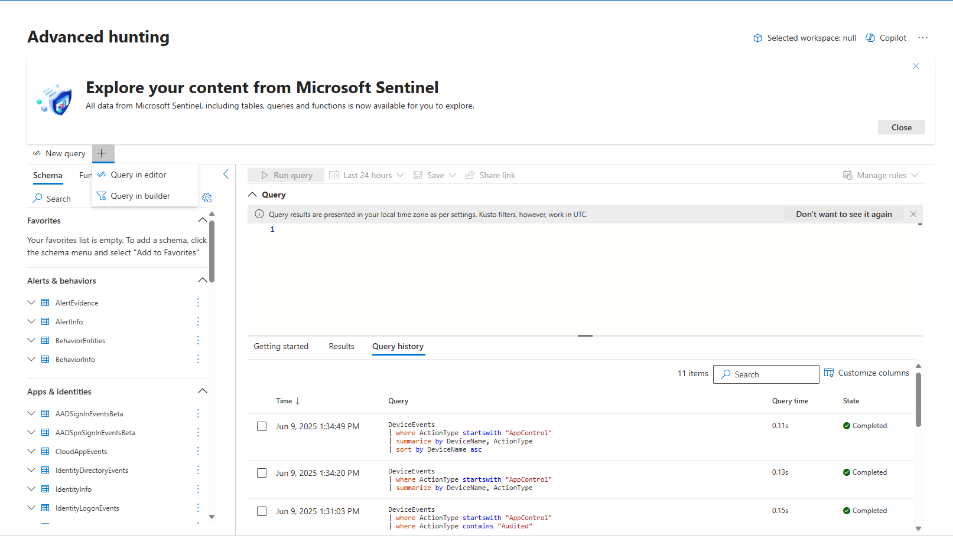

Slide 5
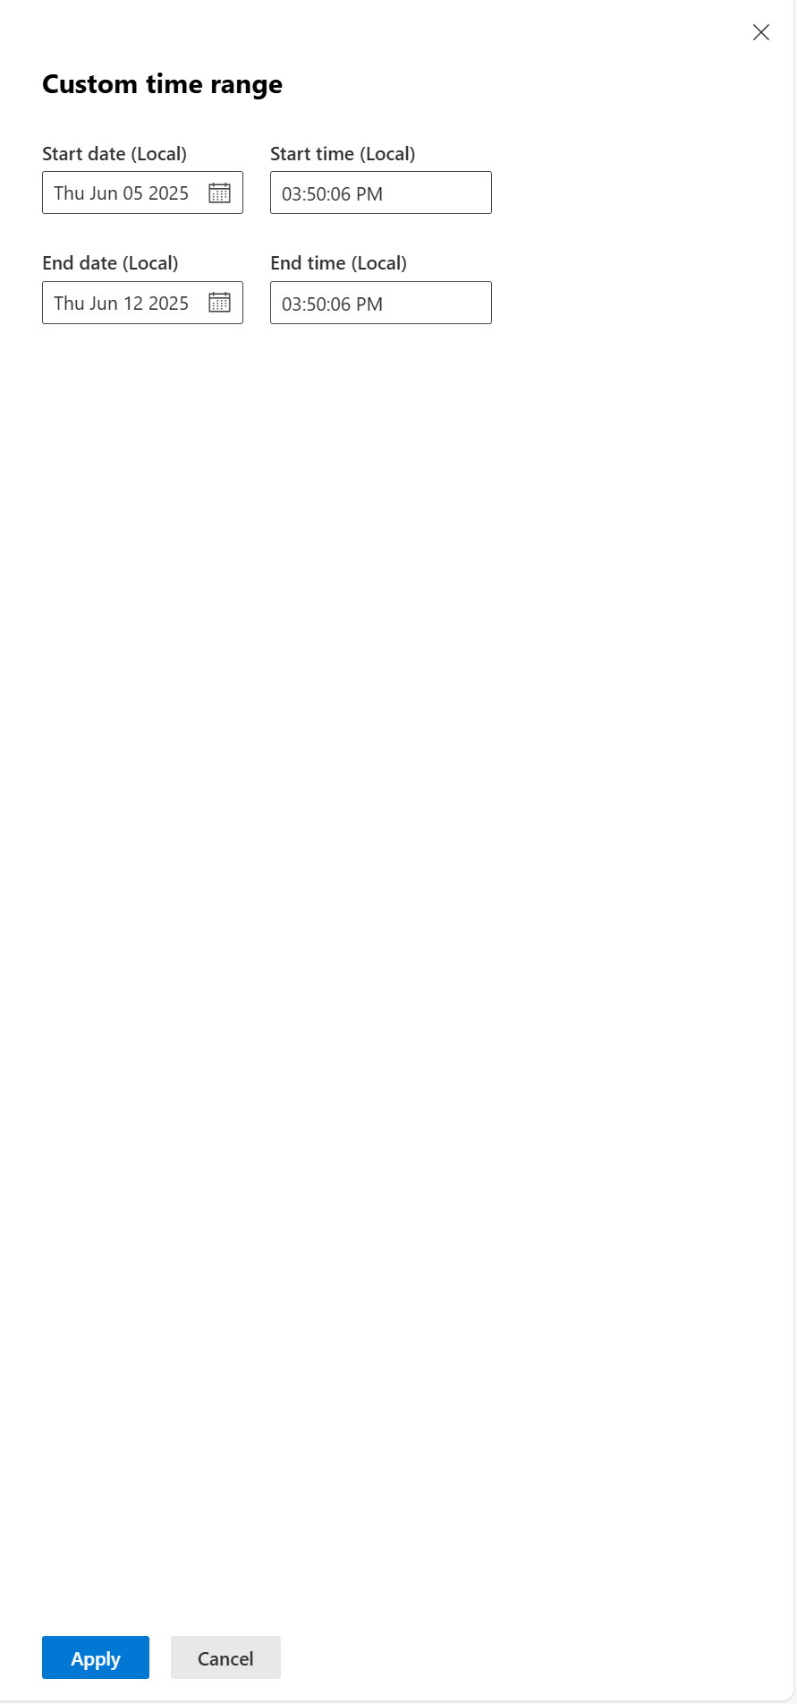
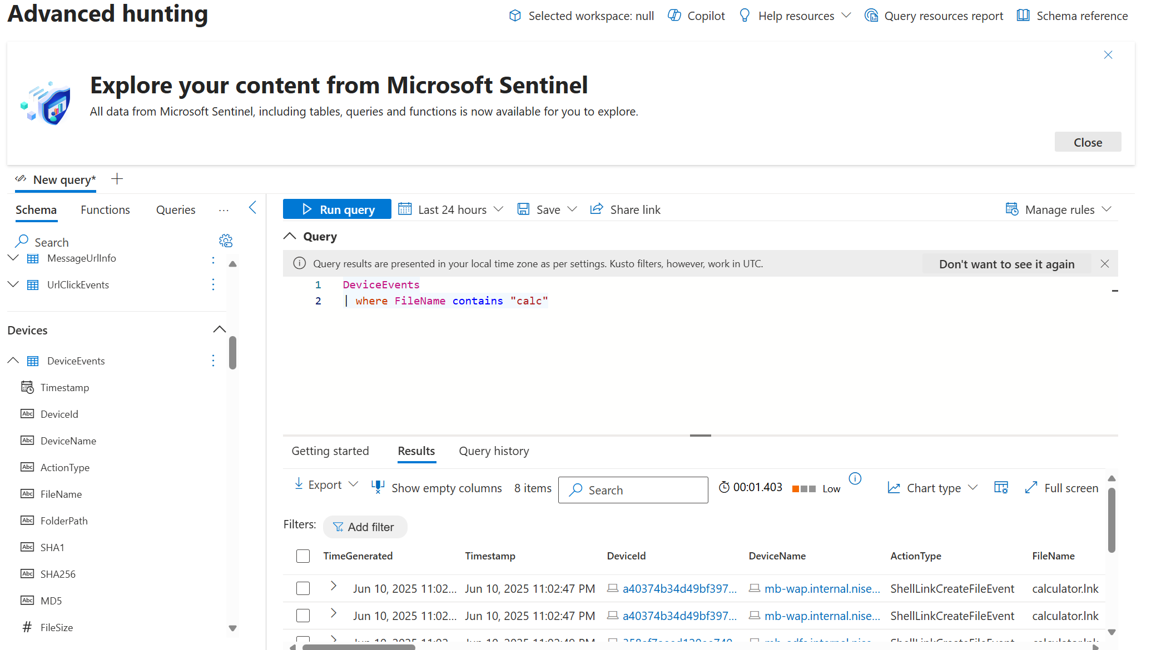
Parsers , Saved Queries
Key Trick:
Shift + Enter
Implicit Time Filter
| where Timestamp >= ago(30d)
Tables
Query Performance
Maximize your space
Typed Columns

Slide 6
Anatomy of a KQL query

Slide 7

Understanding the pipe
DeviceEvents | where ActionType == "NamedPipeEvent" | summarize count() by InitiatingProcessCommandLine | top 10 by InitiatingProcessCommandLine
Pivot
Filter & prepare
Analyze
Prepare
Data
Condition
Evidence

Slide 8
Select your Data

Slide 9
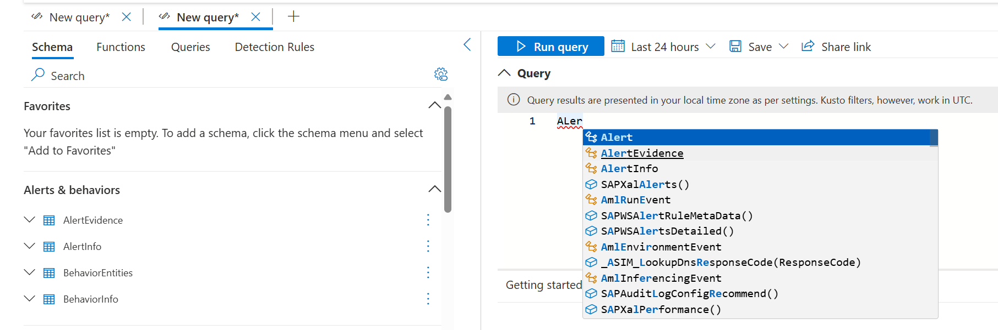
Choose a table
Just use the table name:
Standard tables
Custom tables _CL
Type produces IntelliSense of tables and commands
DoubleClick to Add to Query
Or
“search” - query multiple tables
Notes:
Stored functions also act as parsers, or saved queries that can be parametrized for inputs | like a PS that acts as a function withinputs like Ip Addresses, and Account Name

Slide 10
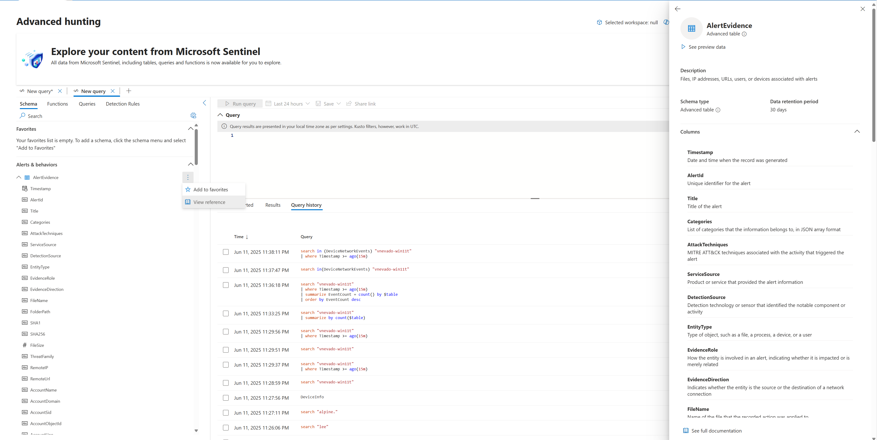
Getting Schema

Slide 11
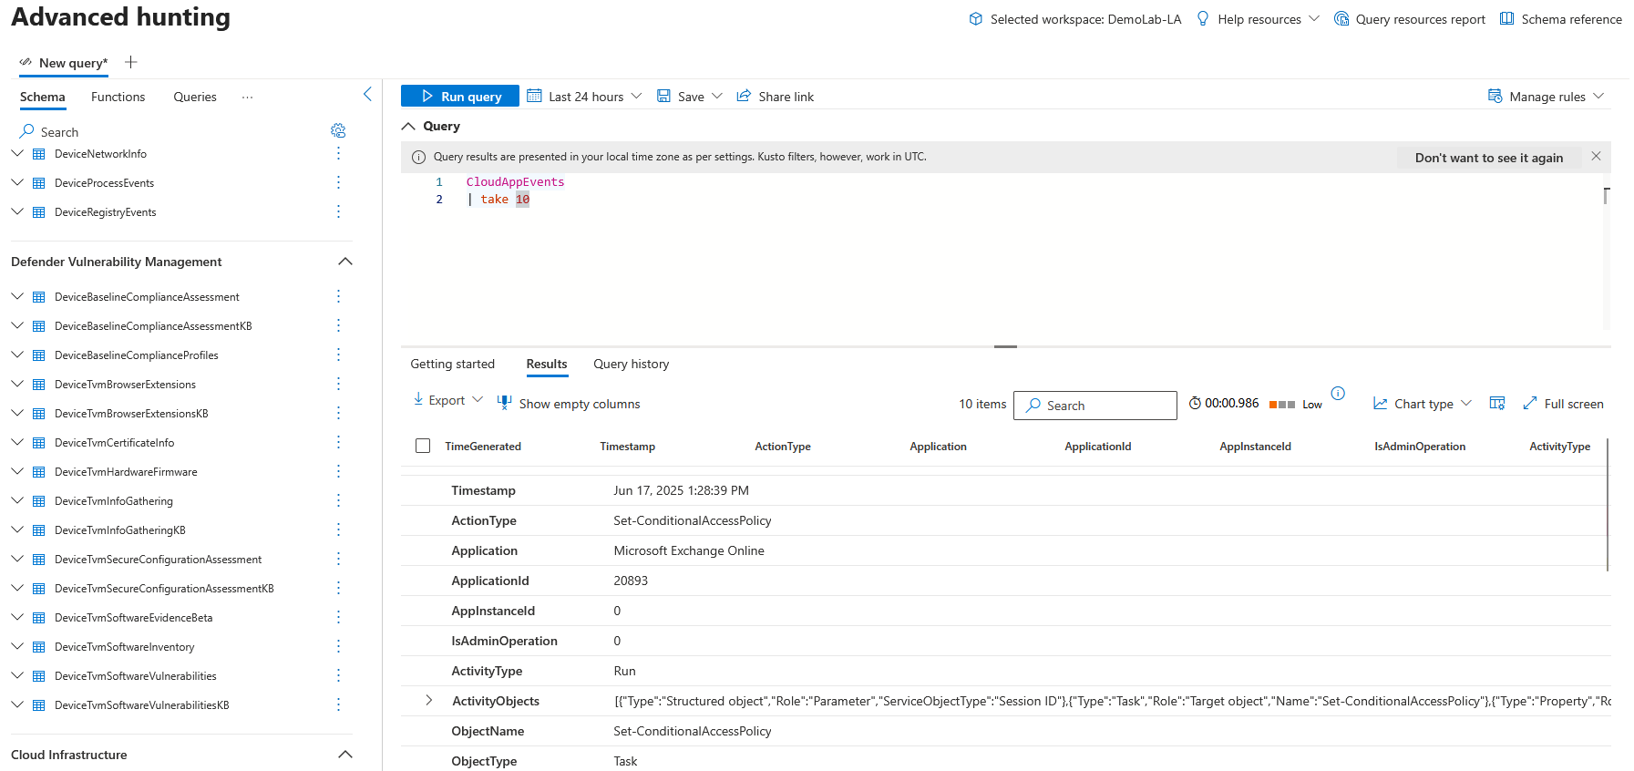
'take 10'

Slide 12
'search' operator
Searches a text pattern in multiple tables and columns.
Easy to use. Very inefficient! Use to find where data you need is located, but not in final queries.
Syntax: [Table |] search “string” [in (Tables)]
Examples: search '10.1.5.5'
SecurityEvent | search 'Guest'
“T |” and “in (Tables)” are optional. With no table specified will search all tables.
The “$table” field will include the table name if a multi-table search.
Notes:
Use simple comparisons between column names and constants. ('Constant' means constant over the table - so now() and ago() are OK, and so are scalar values assigned using a let statement.)
For example, prefer where Timestamp >= ago(1d) to where floor(Timestamp, 1d) == ago(1d).
Simplest terms first: If you have multiple clauses conjoined with and, put first the clauses that involve just one column. So Timestamp > ago(1d) and OpId == EventId is better than the other way around.

Slide 13
Search – enhance, enhance, enhance
// does it exist ?
search "vnevado-win11t"
// where and how often does it exist ?
search "vnevado-win11t"
| summarize EventCount = count() by $table
| order by EventCount desc
// why does it exist ?
search in (DeviceNetworkEvents) "vnevado-win11t"

Slide 14
Filter & Prepare

Slide 15
‘where’ operator
Start with filtering by time
Time range type
DeviceLogonEvents
| where Timestamp > ago(14d)
DeviceLogonEvents
| where Timestamp > ago(14d) and ActionType == "LogonFailed" // Failed logon
DeviceLogonEvents
| where Timestamp > ago(14d)
| where ActionType == "LogonFailed"
| where Protocol =~ "ntlm"
DeviceLogonEvents | where ActionType in ("LogonSuccess", "LogonAttempted")
DeviceNetworkEvents | where ipv4_is_match(LocalIP, "10.0.0.0/8")
Relative times
Case insensitive
Lists can be dynamic
Breadth of operators

Slide 16
‘extend’ operator
Create calculated columns and append them to the result set
Syntax: T | extend ColumnName [= Expression] [, ...]
Example: SecurityEvent | extend ComputerNameLength = strlen(Computer)
The new added column is not stored.
To only change a column name, use ‘project-rename’.
Expression capabilities are endless.
Used for parsing.

Slide 17
‘extend’ exercise
DeviceInfo
| where OSPlatform == "Linux" or OSPlatform contains "WindowsServer"
| distinct DeviceName
| summarize count()
| extend ['DfS P1 Pricing'] = count_ * 5
| extend ['DfS P2 Pricing'] = count_ * 15
SecurityEvent | where EventID in (4624, 4625) | extend rgroup = extract("resourcegroups/(.*)/providers",1,_ResourceId)
… | extend rgroup = split(_ResourceId, "/",4)[0]
… | parse _ResourceId with "/subscriptions/" sub "/resourcegroups/" rgroup "/providers" *
Use “extract” to parse a value
or “split”, "extract_all“ or “parse”

Slide 18
Lab #1: filtering
Certain Device based tables have authentication events
Find all failed login starting 2 weeks ago until 1 week ago that occurred on a computer with name which starts with “Ash”.
Hints and guideline:
Certain Device based tables have authentication events
What is the name of the field which contains the event ?
What is the name of the field which represents the computer name?
What should be the order of the commands, but better performance?
Notes:
SecurityEvent | limit 100 // find Activity, EventID, Computer
SecurityEvent | summarize by Activity
SecurityEvent | summarize by Computer
SecurityEvent | where TimeGenerated between (ago(14d)..ago(7d)) | where EventID == "4624“ | where Computer startswith "App“ // case insensitive
SecurityEvent | where TimeGenerated between (ago(14d)..ago(7d)) | where EventID == "4624“ | where Computer startswith "App“ | summarize count() by Computer

Slide 19
Lab #1 solution, in steps
// Find all failed attempts to login starting 2 weeks ago until 1 week ago that occurred on a computer with name which starts with “Ash”
DeviceLogonEvents | limit 100 // Find relevant fields: FailureReason, ActionType, DeviceName
DeviceLogonEvents | summarize by FailureReason // find the Event signaling
DeviceLogonEvents
| where Timestamp between (ago(14d)..ago(7d)) // start with the time filter
| where ActionType == "LogonFailed"
| where DeviceName startswith "Ash" // case insensitive
// This is the solution, but there are so many results
DeviceLogonEvents
| where TimeGenerated between (ago(14d)..ago(7d))
| where ActionType == "LogonFailed"
| where DeviceName startswith "Ash"
| summarize count() by DeviceName
// so let’s count per computer
Notes:
Can also use between(ago(14d)..ago(7d))

Slide 20
Analyze

Slide 21
Understanding the pipe
SecurityEvent | where EventID == "4624" | summarize count() by Account | top 10 by _count
Pivot
Filter & prepare
Analyze
Prepare
Data
Condition
Evidence

Slide 22
‘summarize’ command
Produces a table that aggregates/groups the content of the input table.
Syntax: T | summarize Aggregation [by Group Expression]
Examples: DeviceEvents | summarize count() by DeviceName
Simple aggregation functions: count(), sum(), avg(), min(), max(),
Advanced functions: arg_min(), arg_max(), make_list(), countif()

Slide 23
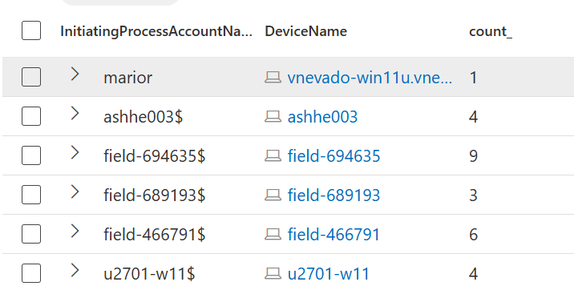
‘summarize’ exercise
Count distinct accounts for selected data set. Returns a single value.
UrlClickEvents
| summarize dcount(AccountUpn)
DeviceEvents
| where ActionType == "ScheduledTaskCreated"
| summarize count()by InitiatingProcessAccountName, DeviceName
Count tasks by user and davice
Note the default column name. Use c=count() to override

Slide 24
Lab #2: analysis
Find how many times each process ran per computer
Hints and guideline:
Action around named pipe events logs process creation.
Which field represent the processes created and which the computer on which it was ran?

Slide 25
Lab #2 solution, in steps
// Find how many times each process ran per computer
DeviceEvents | summarize by InitiatingProcessFileName // Let’s find the event that includes process names
DeviceEvents | where ActionType == "NamedPipeEvent" | limit 10
// find the relevant field, in this case "Process"
DevicesEvents
| where ActionType == "NamedPipeEvent"
| summarize count() by InitiatingProcessFileName, DeviceName
Notes:
Can also use between(ago(14d)..ago(7d))

Slide 26
A real-world example: password spray detection
let timeframe = 1d;
let threshold = 3;
SigninLogs
| where TimeGenerated >= ago(timeframe)
| where ResultType == "50057"
| where ResultDescription =~ "User account is disabled. The account has been disabled by an administrator."
| summarize applicationCount = dcount(AppDisplayName) by UserPrincipalName, IPAddress
| where applicationCount >= threshold
Filter failed login attempts to disabled accounts
Summarize distinct applications attempted per username and source IP
Determine if over a threshold
https://github.com/Azure/Azure-Sentinel/blob/master/Solutions/Microsoft%20Entra%20ID/Analytic%20Rules/DisabledAccountSigninsAcrossManyApplications.yaml

Slide 27
Prepare

Slide 28
Understanding the pipe
SecurityEvent | where EventID == "4624" | summarize count() by Account | top 10 by _count
Pivot
Filter & prepare
Analyze
Prepare
Data
Condition
Evidence

Slide 29
‘sort by | order by’ exercise
Note use of ’case’. Last input value (-1) is the default.
SecurityAlert
| where TimeGenerated > ago(7d)
| extend severityOrder = case (
AlertSeverity == "High", 3,
AlertSeverity == "Medium", 2,
AlertSeverity == "Low", 1,
AlertSeverity == "Informational", 0,
-1)
| order by severityOrder
| project-away severityOrder
‘project-away’ removes unneeded fields from the result set

Slide 30
‘project’ operator
Select the columns to include, rename or drop, and insert new computed columns.
Syntax: T | project ColumnName [= Expression] [, ...]
Example: AADSignInEventsBeta | project AccountUpn, IPAddress, Country, AccountObjectId
‘| project-away’ – Removed specified column/s.
‘| project-rename’ – Rename specified column/s.

Slide 31
‘project’ exercise
DeviceTvmSoftwareVulnerabilities
| project DeviceName, SoftwareName, IsImportant = iff(DeviceName contains "-dc", true, false)
An “if” function similar to Excel’s.

Slide 32
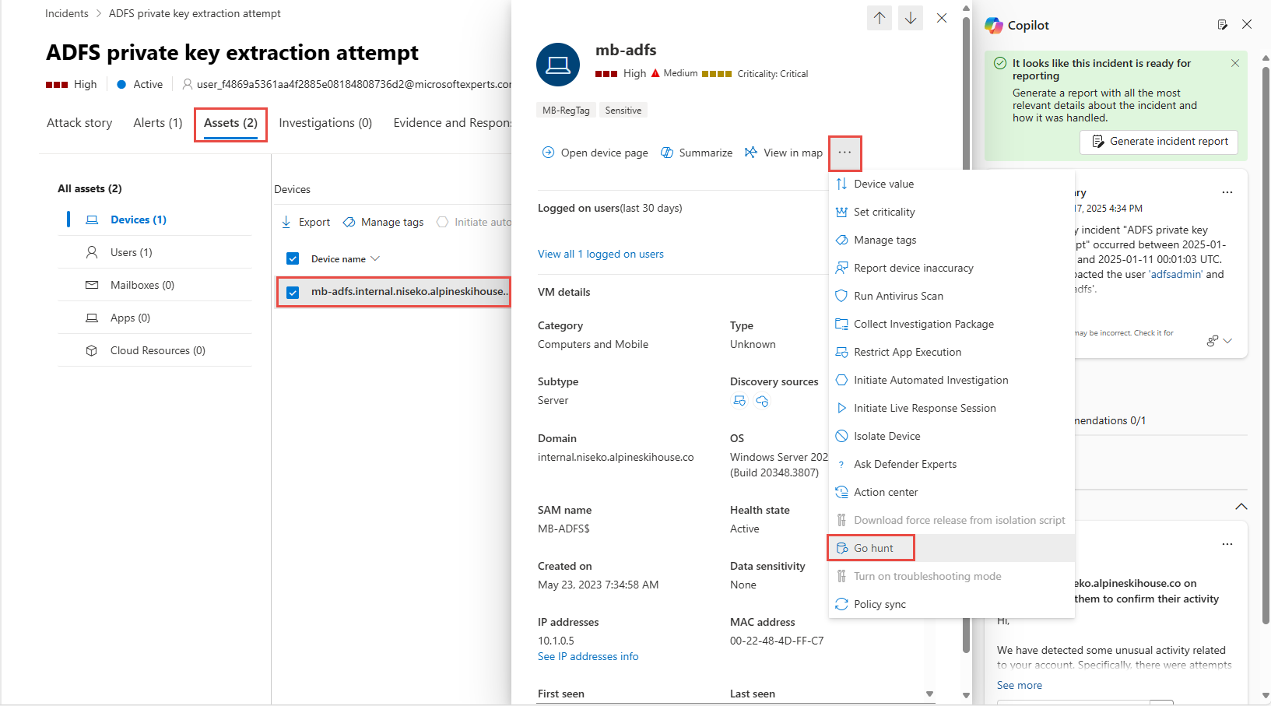
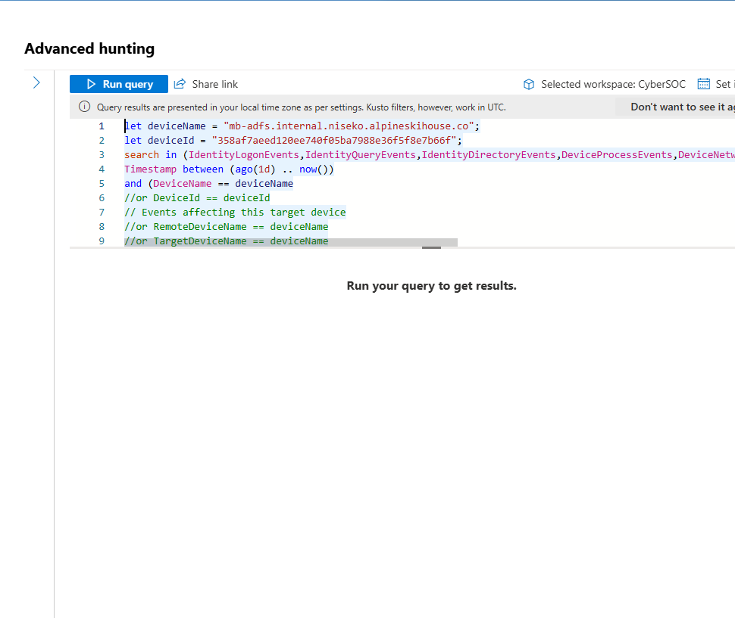
Go Hunt in Defender incidents

Slide 33
Visualize

Slide 34
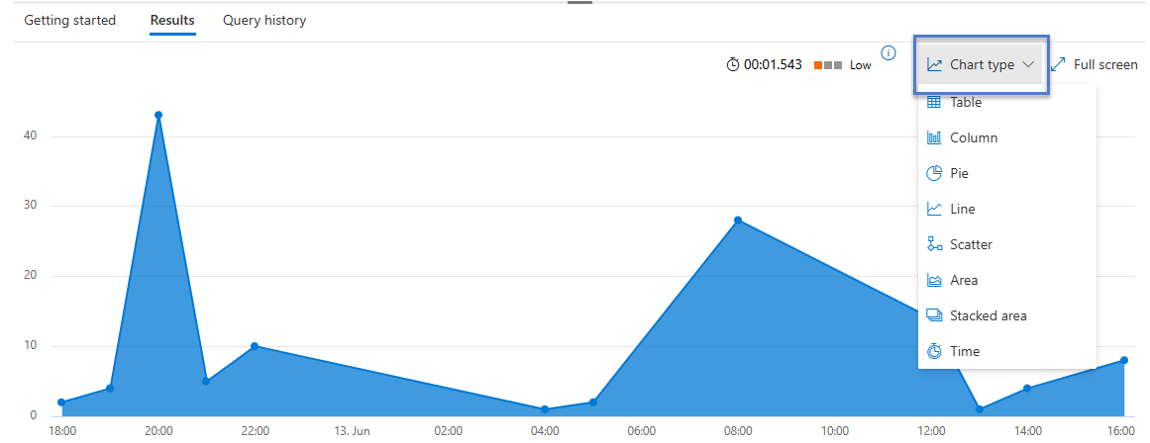
Render operator
Generates a visualization of the query results.
Syntax: T | render Visualization [with ( PropertyName = PropertyValue [, ...] )]
Supported visualizations:
areachart
columnchart
linechart
plotly
piechart
Scatterchart
table
timechart
treemap

Slide 35
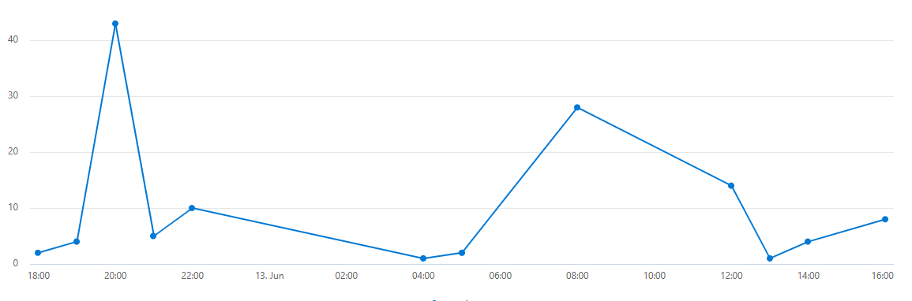
’bin’ and time series
Bin is essentially the ‘floor’ function. It is very useful in summarize operations to creating time series.
DataSecurityEvents
| summarize count() by bin(Timestamp, 1h)
| render timechart
Can create multiple overlaying charts by aggregating additional field
Notes:
Bin is floor
Mostly useful for time
Useful for baselines and identifying spiks
Usually I don’t put render

Slide 36
‘bin’ exercise
EmailPostDeliveryEvents
| where Timestamp > ago(7d)
| summarize count() by bin(TimeGenerated, 1d)
VMConnection
| summarize count() by SourceIp | sort by count_ desc | render barchart

Slide 37
Lab #3: visualization
Chart the rate of process creation on all domain controllers.
Hints and guideline:
Process creation is ProcessCreated
Domain controller names end with “-dc” before going into remaining fqdn elements
Create multiple charts by aggregating additional more than one field
Search for bin windows in KQL
Notes:
Ago()
Explain about SecurityEvents and OfficeActivity
@ makes the \

Slide 38
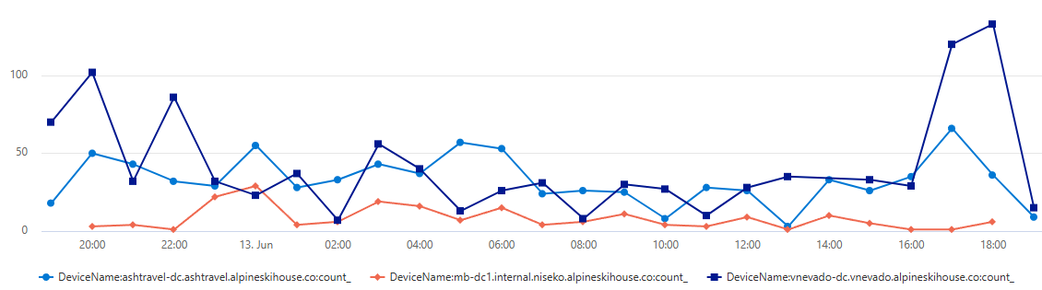
Lab #3 solution
// Chart the rate of process creation on all domain controllers.
DeviceProcessEvents
| where DeviceName contains "-dc"
| where ActionType == "ProcessCreated" | summarize count() by DeviceName, bin(Timestamp, 1h)
| render timechart

Slide 39
Advanced topics

Slide 40
Back on ‘search’ shortcuts
Syntax | Meaning (equivalent where)
search "err" | union * | where * has "err"
search in (T1,T2,A*) and "err" | union T1,T2,A* | where * has "err"
search col:"err" | union * | where col has "err"
search col=="err" | union * | where col == "err"
search "err*" | union * | where * hasprefix "err"
search "Lab*PC" | union * | where * matches regex @"\bLab\w*PC\b"
search "abc" and ("def" or "hij") | union * | where * has "abc" and (* has "def" or * has hij")

Slide 41
‘union’ operator
Takes two or more tables and returns the rows of all of them (“one under another”).
Example:
DeviceEvents
| union (DeviceNetworkEvents | where ActionType == "ConnectionSuccess")
kind=inner(return only common columns from both tables), outer (default, return all columns, set null for absent data)
Supports wildcard to union multiple tables (union Message*)
ID | Name
1 | John
2 | Mary
ID | Name
3 | Robert
4 | Andrew
ID | Name
1 | John
2 | Mary
3 | Robert
4 | Andrew

Slide 42
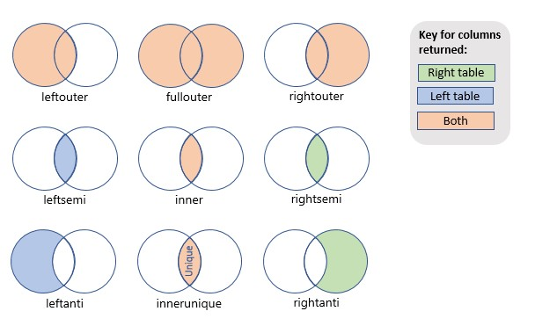
‘join’ operator
Merge the rows of two tables to form a new table by matching values of the specified column(s) from each table.
Syntax: LeftTable | join [JoinParameters] ( RightTable ) on Attributes
Example: DeviceInfo | join (DeviceNetworkEvents | where RemoteIPType == "Public") on DeviceId

Slide 43
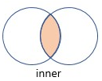
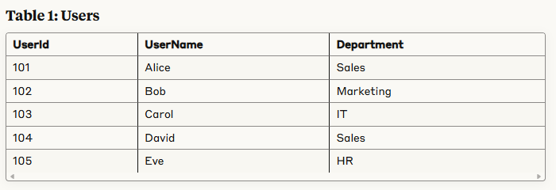
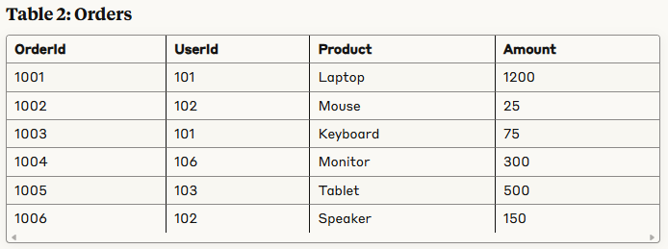

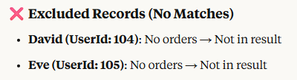
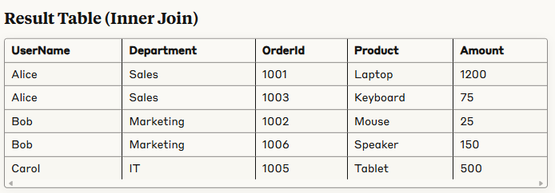
KQL Inner Join (exclude) - Visual Example
Users
| join kind=inner ( Orders ) on UserId
| project UserName, Department, OrderId, Product, Amount

Slide 44
Working with JSONs and arrays
Parse_json() - Interprets the string as a JSON value and returns the value as dynamic. If possible, the value is converted into relevant data types. For strict parsing with no data type conversion, use extract() or extract_json() functions.
mv-expand – Duplicate records, creating copies each one with one value of a JSON array. Easiest way to process JSON arrays.
mv-apply – Apply a query to each value in an array.

Slide 45
JSON exercise
AdditionalFields looks like a JSON but is a string and requires the use of todynamic
DeviceEvents
| where ActionType == "PnpDeviceConnected"
| extend ATDynamic = todynamic(AdditionalFields)
| extend ClassName = ATDynamic.ClassName
| extend DeviceDescription = ATDynamic.DeviceDescription
| project DeviceName, ClassName, DeviceDescription
DeviceEvents
| where ActionType == "PnpDeviceConnected" | project ATDynamic = parse_json(AdditionalFields)
| evaluate bag_unpack(ATDynamic)

Slide 46
Additional Links
Use the open to use KQL playground to exercise the labs
Consult with the:
KQL documentation
Pluralsight KQL course
Pluralsight Advanced KQL course
KQL cheat sheet

Slide 47
Very Neat Links
Checkout:
Uncoder.io
Get Hands-On KQL Practice with this Microsoft Sentinel Workbook - Microsoft Community Hub
Reprise99's Query Packs (365 Days of KQL)
Bert JanP – Hunting Queries
Kusto Detective Agency
KC7 Cyber – Ballons Over Iowa
KQL Search
KQL Café (Meetup)
Chat GPT-4 Research

Slide 48
Thanks to
Ken Sicinski – envisioning this
Andrey Sheremetinskiy – co presenting and editing down
Arlie Hartman – bouncing ideas off of
Peter Atkinson – Join example
Nathan Swift – co presenting and refactoring

